Slide 1
Vs Code Macro
발표자 2017314380 윤성경

Slide 2
INDEX
Vs Code Macro
When we need this Macro?
How to use it?

Slide 3
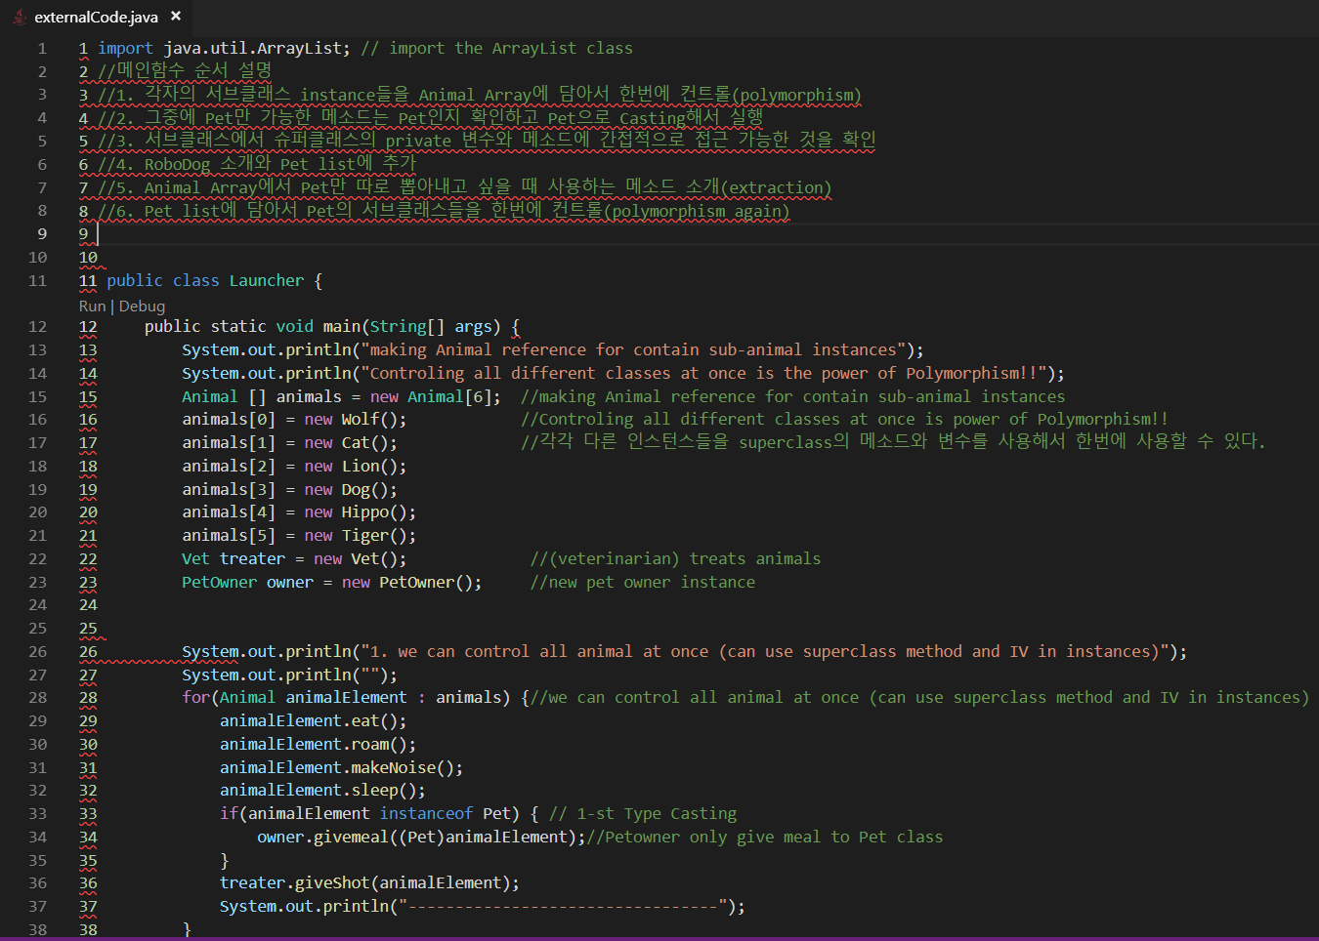
When we need this Macro?

Slide 4
Exercise
Make externalCode.java runnable
Change all of them (console->file)
System.out.println();-> fw.write(); fw.newline();
Indent the file someDirtyCode.js

Slide 5
When we need this Macro?
Refactoring
Quick fix
Structure fix
Fast, Safe, Efficient coding

Slide 6
How to use it? (Window)
Ctrl + / = comment
Shift + ctrl + alt + [pg]up / [pg]down = multicursor
Shift + ctrl + alt + up/down-key = multicursor
Alt + click = multicursor
Shift + Tab = deindent
Right-click + <change all occurrence>
Shift + Alt + F = auto-format
Ctrl + shif + L = cursor at all occurence
Shift + Alt + I = cursor at the end of Line
Ctrl + . = QUICK FIX
Shift + alt + up/down-key = fast copy
Ctrl + D = Find Next word

Slide 7
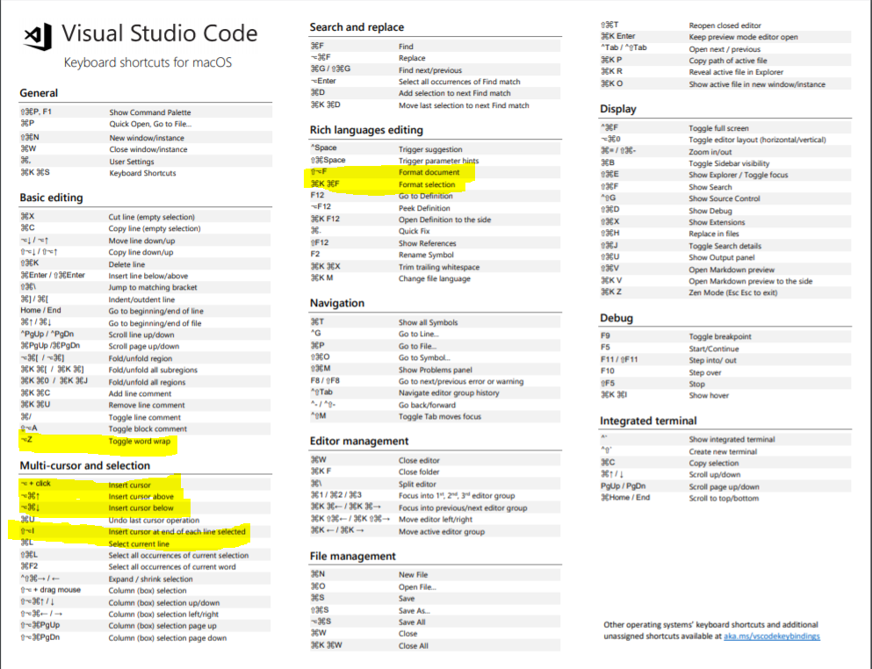
How to use it? (Mac)

Slide 8
Reference to start
Reference Site
https://dev.to/codevault/multi-cursor---visual-studio-code-productivity-features---part-1-1gha
https://code.visualstudio.com/docs/getstarted/tips-and-tricks
(here shows all the macro preset & how to set your own macro)
http://blog.foundy.io/visual-studio-code-shortcuts/
(For mac)
https://www.vobour.com/%EA%B0%9C%EB%B0%9C-%EC%83%9D%EC%82%B0%EC%84%B1%EC%9D%84-%EC%98%AC%EB%A0%A4%EC%A3%BC%EB%8A%94-vscode%EC%9D%98-%EC%86%8C%EC%86%8C-%ED%95%9C-%EA%B8%B0%EB%8A%A5%EB%93%A4

Slide 9
Thank you !
Now you can do it
yourself!

